Slide 1
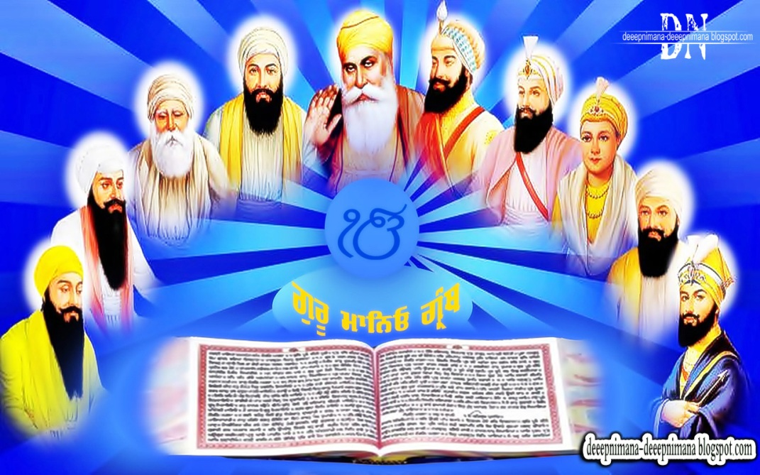
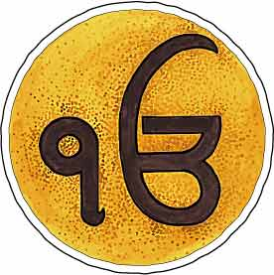
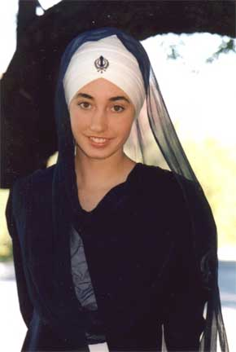
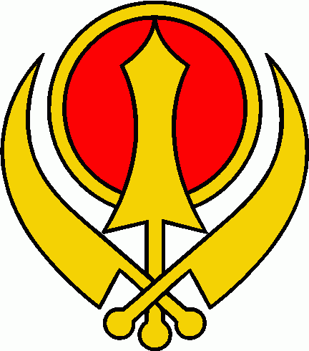
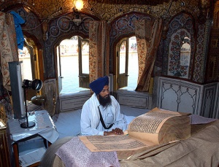
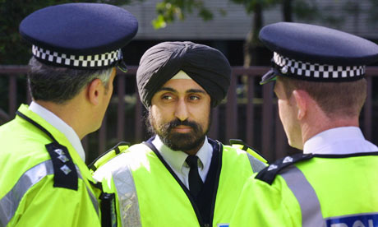
What is the religion?

Slide 2
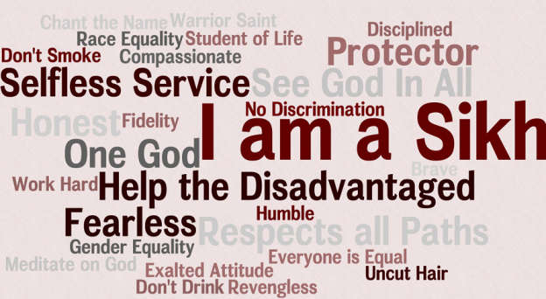

Slide 3
The symbol which appears at the beginning the Sikh scripture and means, "One With Everything". The symbol is written in the Gurumukhi script and has several components.
Ik stands for the Gurumukhi numeral "One".
On is a combination or O and An stands for "Everything".
Kar is inferred and stands for "Creator".

Slide 4
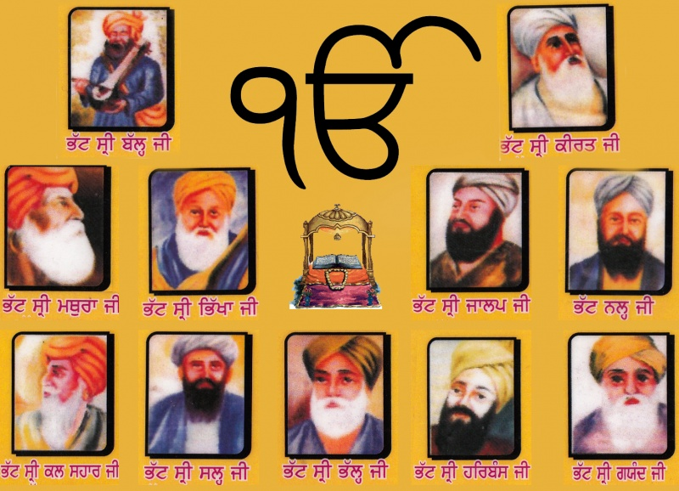
Guru – spiritual teacher – in total there were 10 human teachers in Sikhism

Slide 5
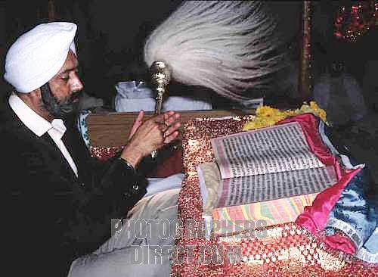
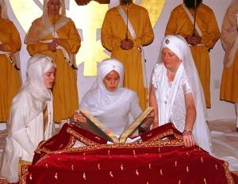
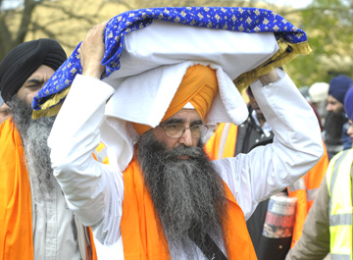
The current Guru or spiritual teacher is a book – The Guru Granth Sahib
It is treated as a human – put to bed – woken up – cleaned – carried – all copies are exactly 1430 pages long

Slide 6
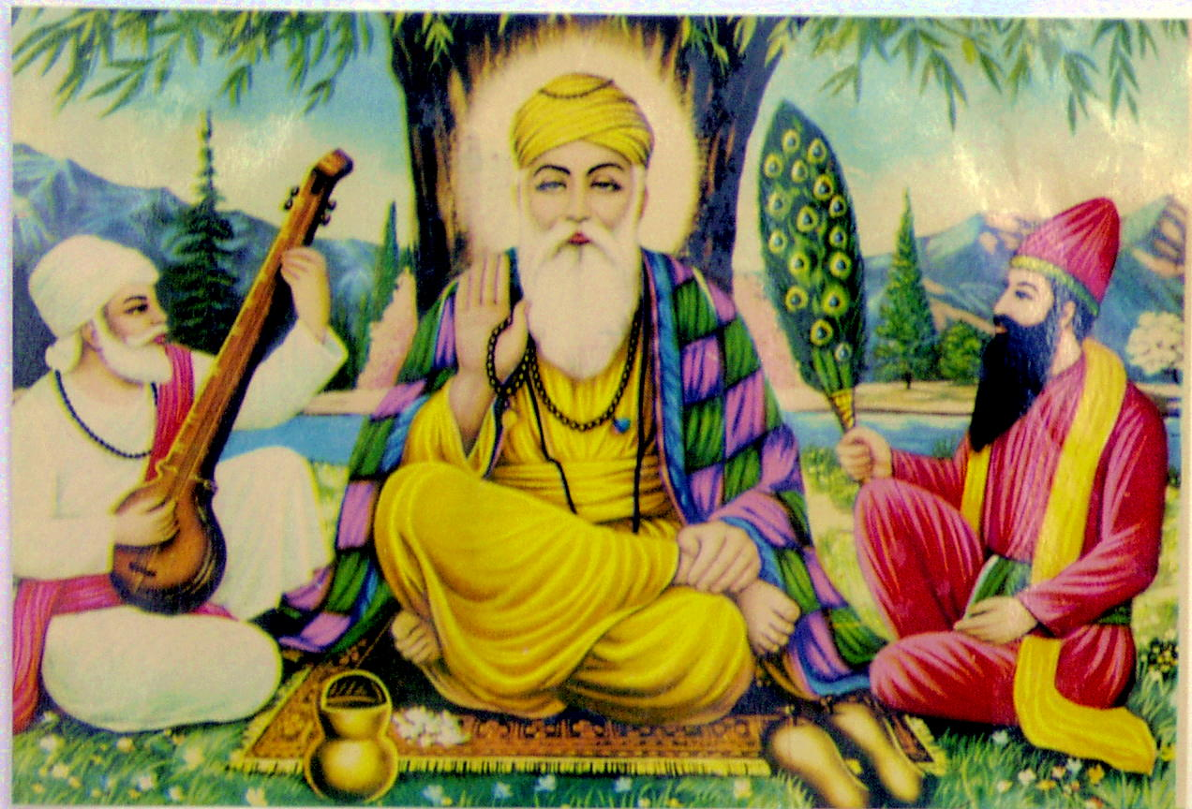
Guru Nanak was influenced by Hinduism and Islam – his close friends were Hindus and Muslims

Slide 7
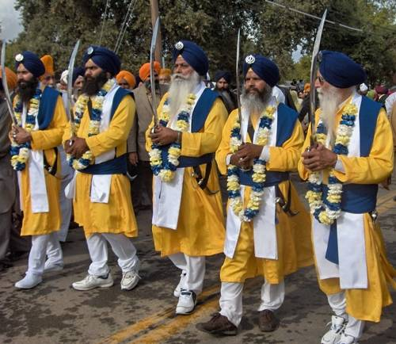
If you decide to become initiated (baptised) into the Sikh faith, then you are expected to wear the 5 K’s

Slide 8
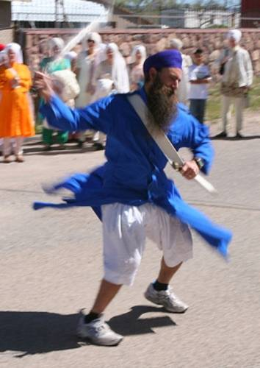
5 k’s - Kachera
Kachhera is a loose undergarment worn by Sikhs. The kachhera is designed for ease of movement while maintaining modesty, whether sitting cross-legged for worship, participating in voluntary work or during martial arts.

Slide 9
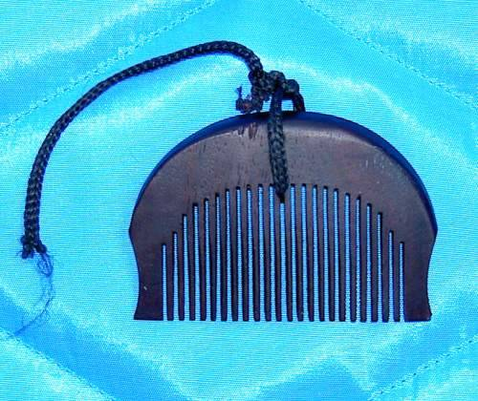
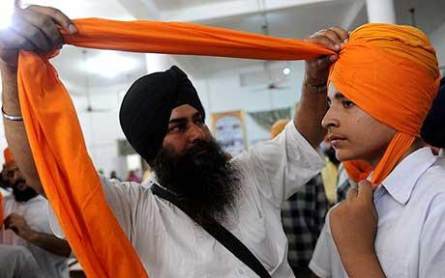
5 K’s - Kanga
The Kanga is a wooden comb. Sikhs do not cut their hair and they must keep it clean. Sikhs comb their hair in the morning before tying a turban, and generally at the end of the day, before sleeping.

Slide 10
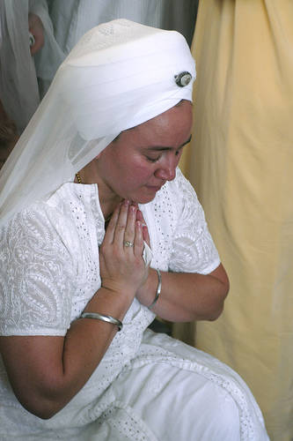
5 k’s - Kara
A kara is an iron or steel bangle worn on the wrist of the right arm. It is a visible reminder of God which like a circle, has no beginning and no end.

Slide 11
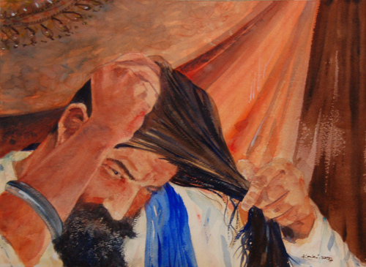
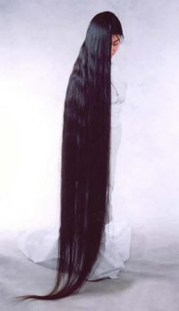
5 K’s – Kesh uncut hair
Kesh includes all facial and body hair. Kesh is to be kept completely intact. This means that a Sikh never cuts, removes, or alters any hair or the head face or body. Many Sikhs testify that kesh has a spiritual significance during meditation and worship.

Slide 12
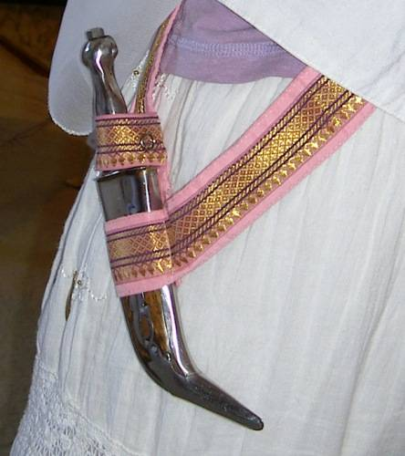
5 K’s - Kirpan
A kirpan is a ceremonial short sword worn by an initiated Sikh. The significance of the kirpan extends to a personal battle fought with ego and is a reminder to be vigilant against the rise of anger, attachment, greed, lust, and pride.

Slide 13
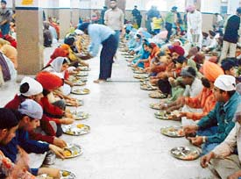
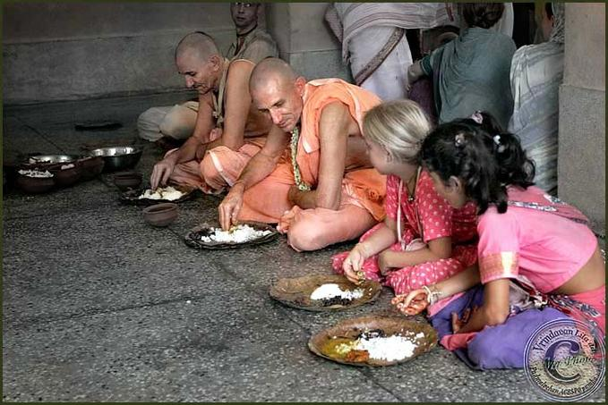
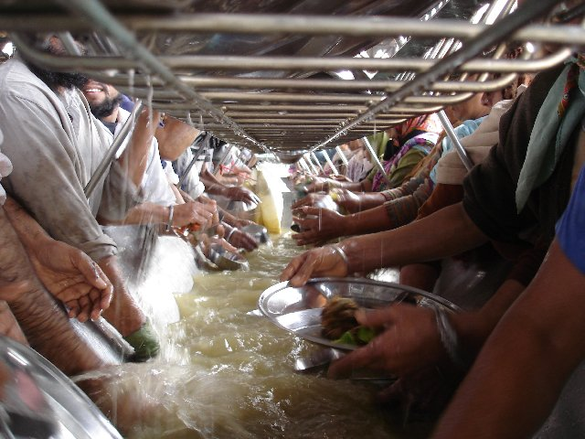
Langar – after worship in the Gurdwara – all Sikhs will eat prasad (sweet food) together and wash up together to show equality. Non-sikhs are welcome to share the food.

Slide 14
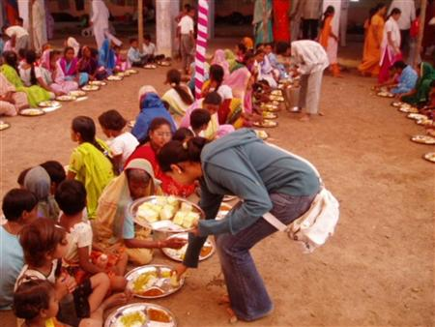
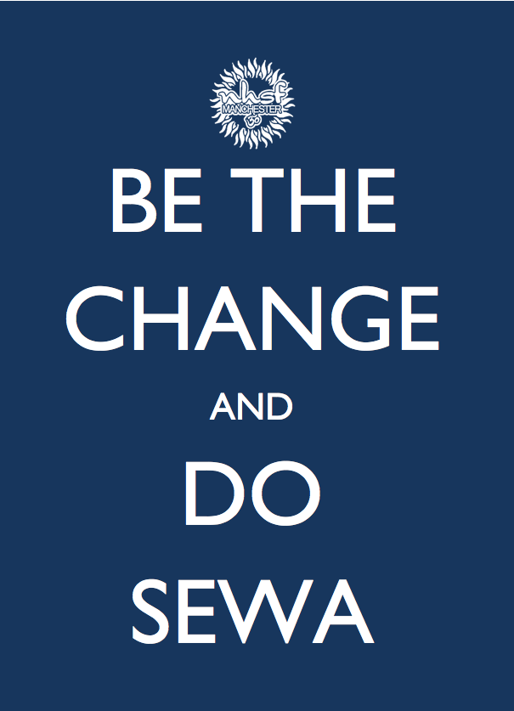
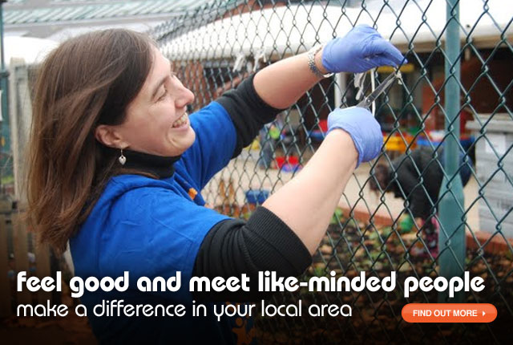
Sewa – selfless work in the community

Slide 15
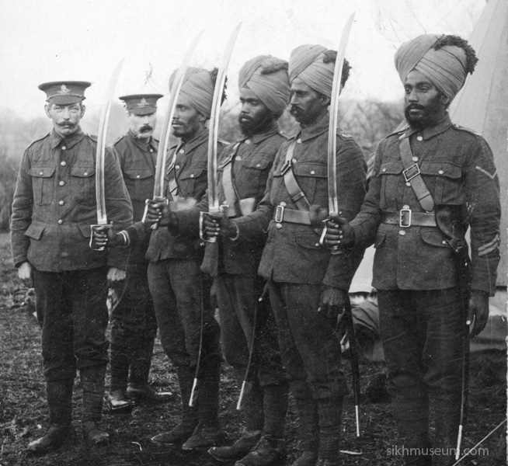
Why all the swords?
The message of the Sikh faith, although peaceful, has a strong theme of justice and upholding human rights running through it.
The Gurus criticized oppressive regimes, The sixth Guru built up an army to defend the rights of the oppressed. The tenth and last living Guru, Guru Gobind Singh, is famous for saying that if all other means fail, the raising of the sword is just.
During the British Raj Sikhs became loyal to the British and made up a large proportion of the British Indian Army, fighting in both World Wars.

Slide 16
