Slide 1
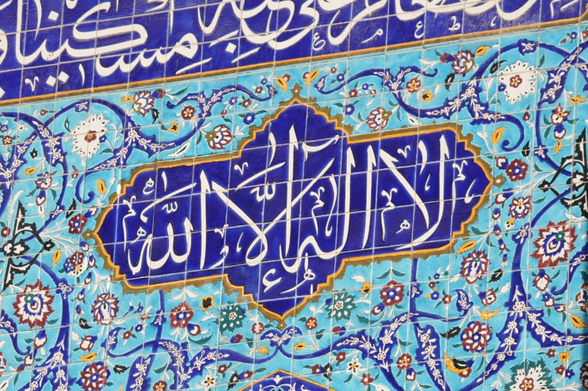
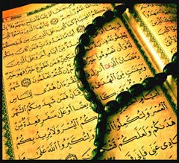
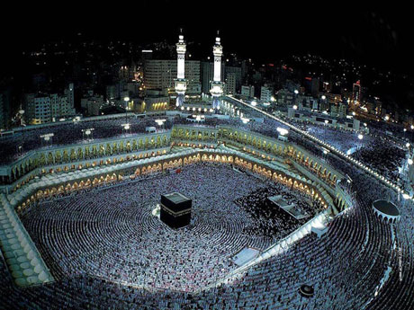
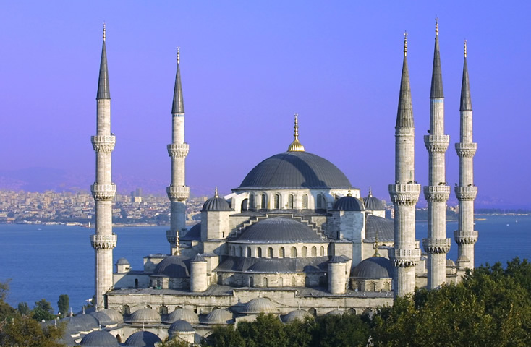
What is the religion?

Slide 2
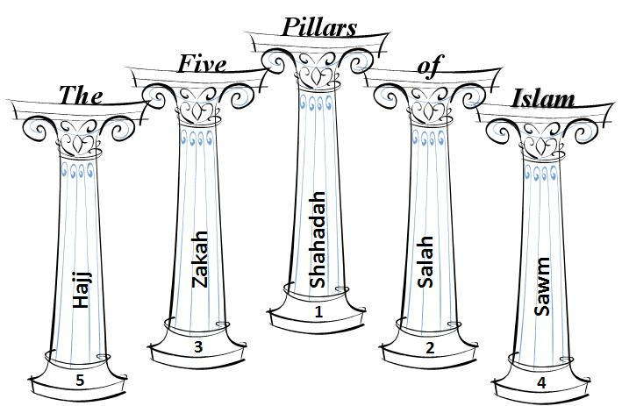
To be a Muslim, there are five essential aspects to life.
http://surreyisoc.net/v2/wp-content/uploads/2010/05/5-pillars-of-islam1.jpg

Slide 3
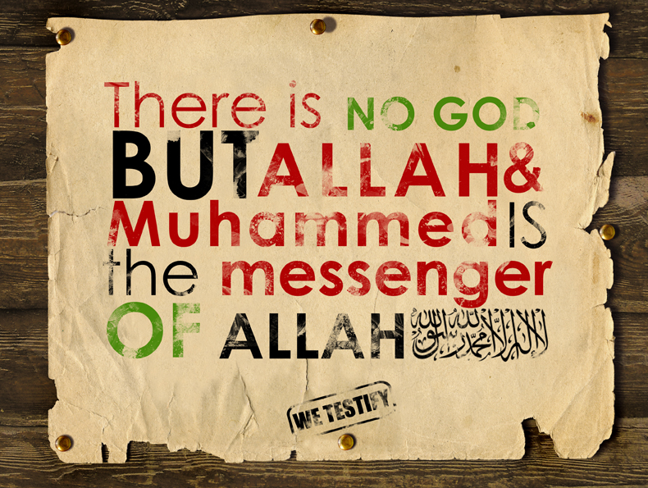
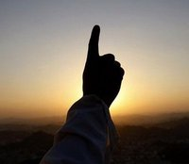
Shahadah – belief in One God (Allah) and Muhammad as the most important messenger

Slide 4
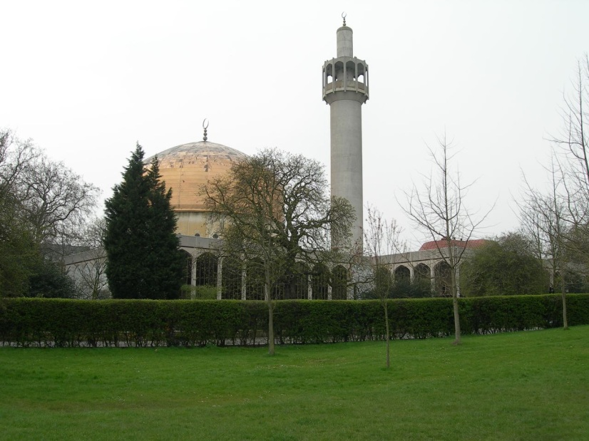
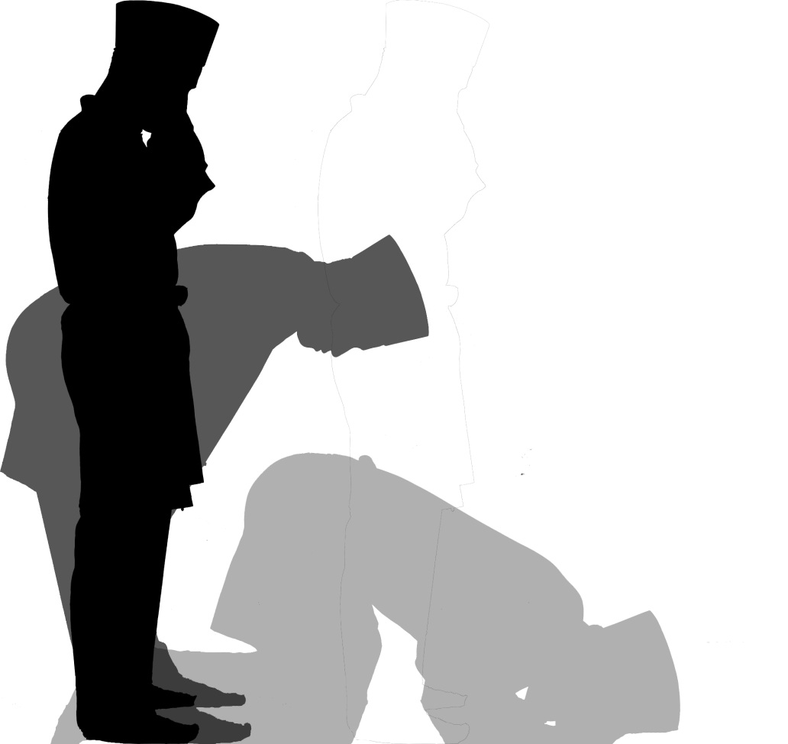
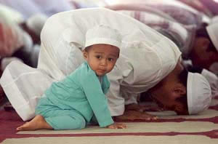
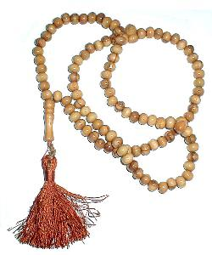
Prayer 5 times a day. In a Mosque or anywhere (as long as there is a prayer mat and you face the direction of Mecca). A Muslims prays with his / her whole body.

Slide 5
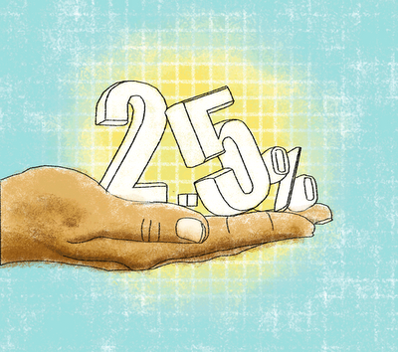
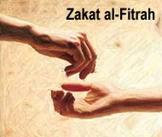
In Islam all things belong to God, money is man-made and to discourage greed, 2.5% of spare capital must be given to the community every year.

Slide 6
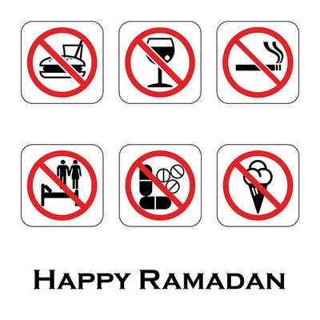
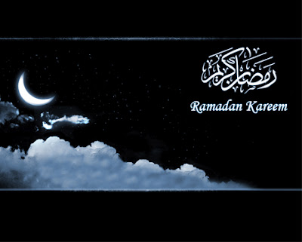
Sawm or fasting during the month of Ramadan – none of the following while the sun is in the sky and for one month a year.

Slide 7
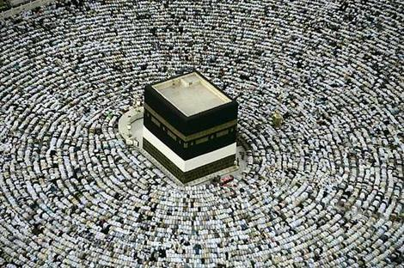
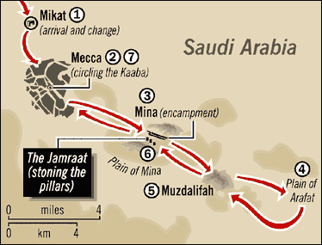
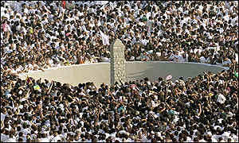
Hajj – once in a life-time a spiritual and ritualistic journey to Mecca

Slide 8
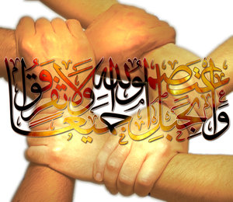
Ummah – Islamic community – unity through faith across the world

Slide 9
From the creation of man, Allah gave messages to 25 men, these men are known as prophets – the last prophet is the final and most important messenger – In Islam, this was Muhammad (peace be upon him)

Slide 10
Muslims and Jews are not allowed to attempt to draw God (God is beyond human understanding) and they must not worship a person (that’s why you will never see a picture of the prophet Muhammad)

Slide 11
Islam is submission to Allah – this means dedicating your life to Allah by following the five pillars of faith

Slide 12
