Slide 1
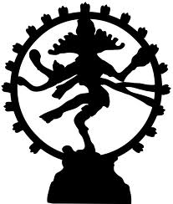
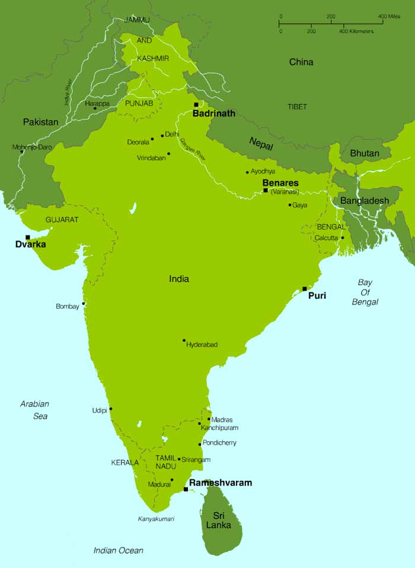
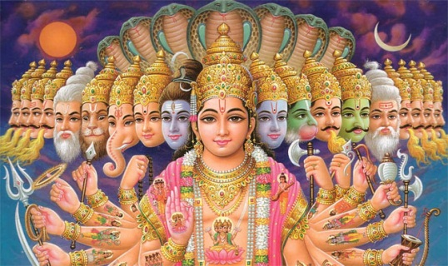
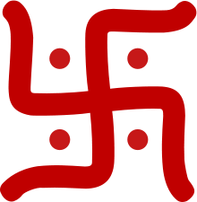
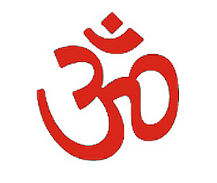
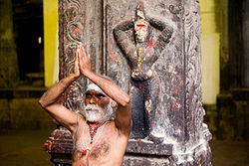
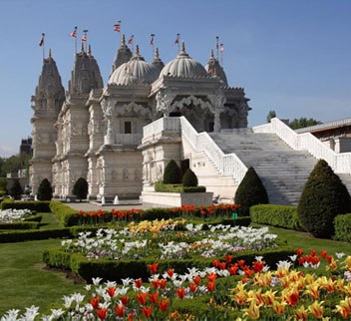
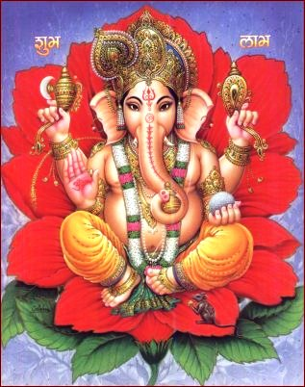
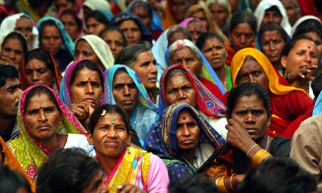
What is the religion?

Slide 2
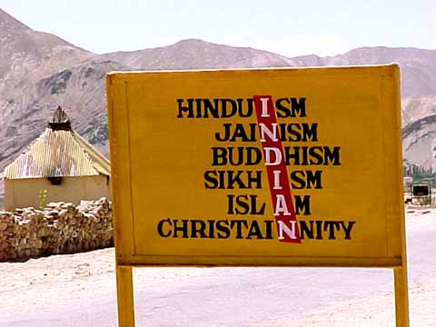
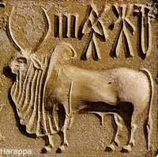
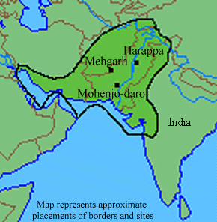
Hinduism
The oldest living religion in the world
So old that it has no founder
“Hindu” comes from the word “Indus”
An ancient civilization lived in the Indus valley, these came to be known as Hindus.

Slide 3
One God - Brahman
This picture shows how the form of the One God Brahman can be split into many different roles and forms without betraying Brahman’s Oneness.

Slide 4
One God in Many Forms
Shiva - destroys
Brahma - creates
Vishnu - preserves

Slide 5
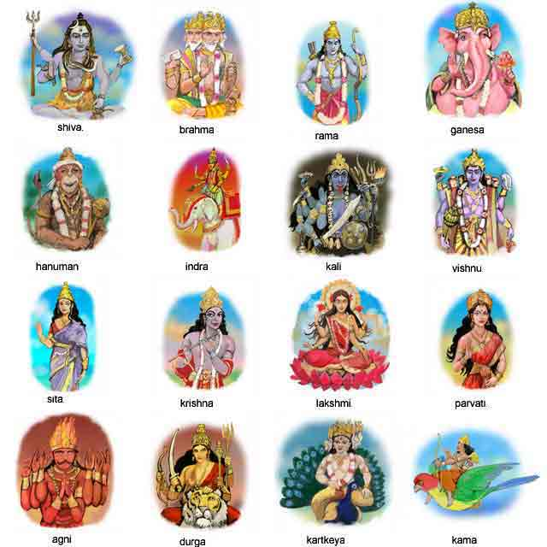
Brahman (the Ultimate Reality – One God) is so great that it’s many parts are represented by male and female goddesses – Hindus say that there are as many as 3 million gods and goddesses!!!!!

Slide 6
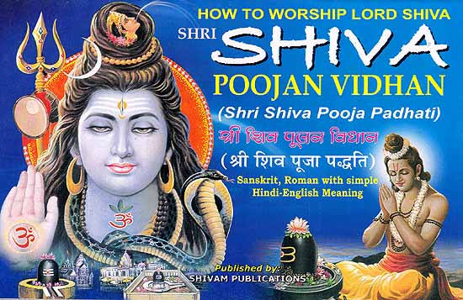
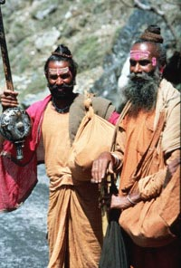
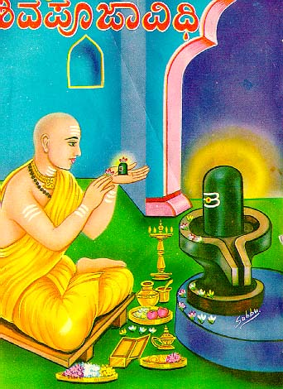
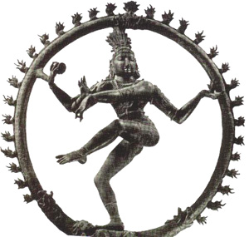
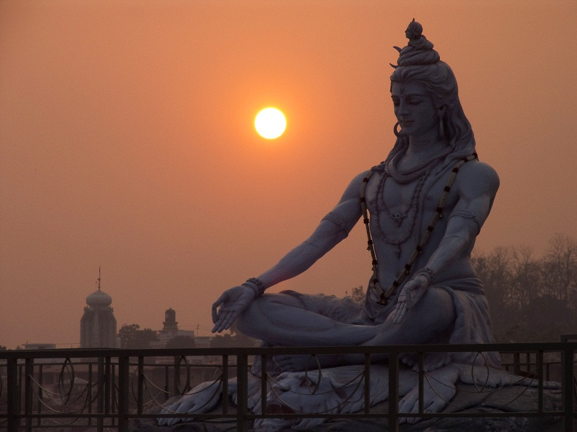
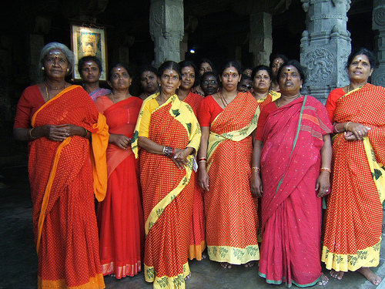
Hindus can worship Shiva

Slide 7
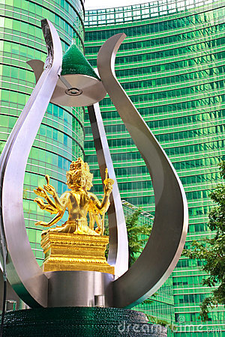
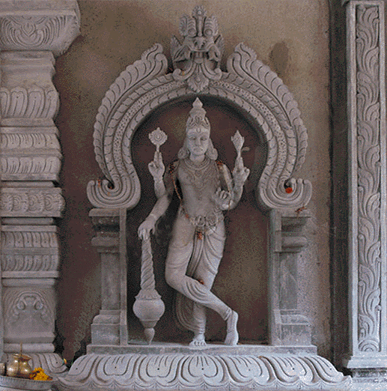
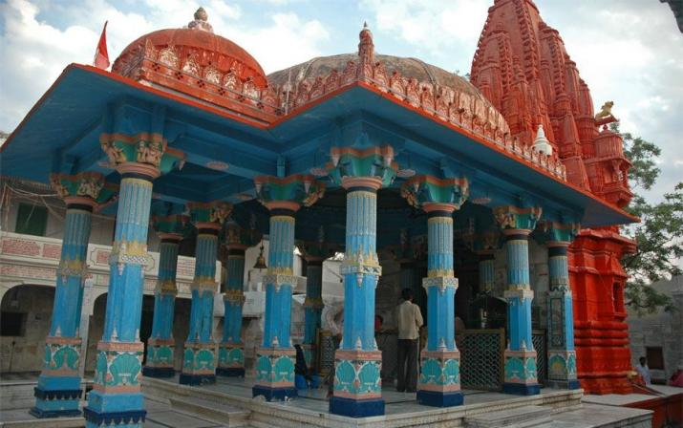
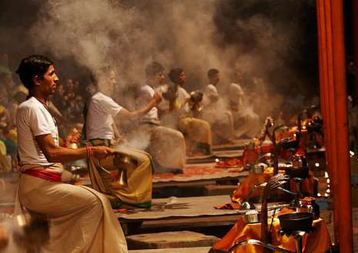
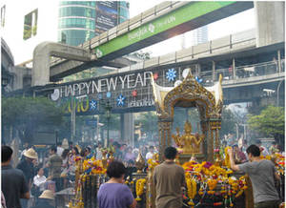
Hindus can worship Brahma

Slide 8
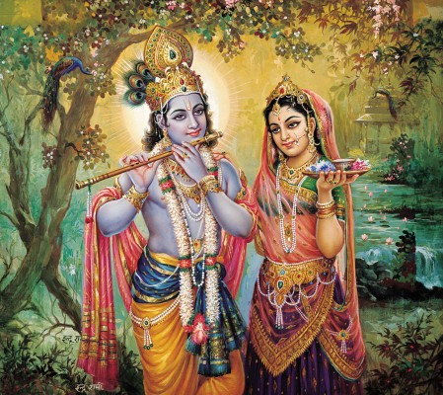
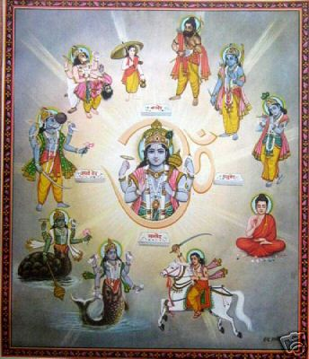
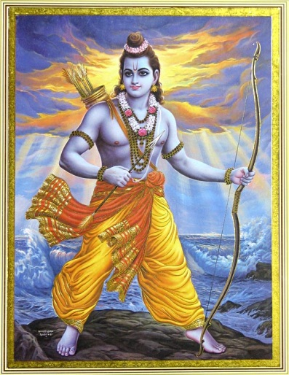
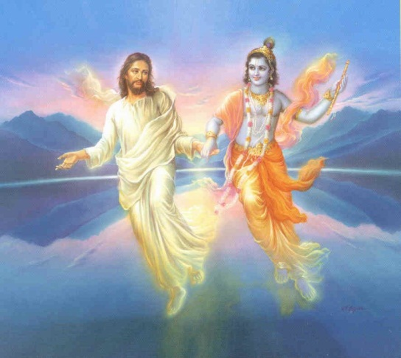
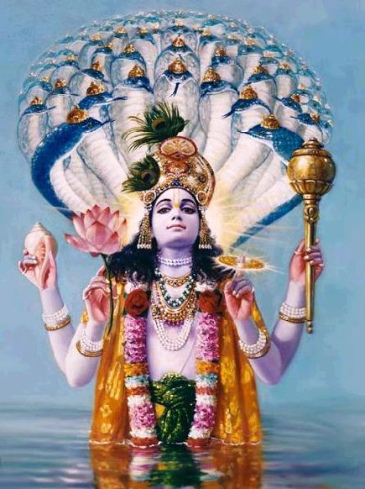
Vishnu came to earth in many different “avatars” or “Incarnations” – Krishna and Rama are the most popular – but there are many others

Slide 9
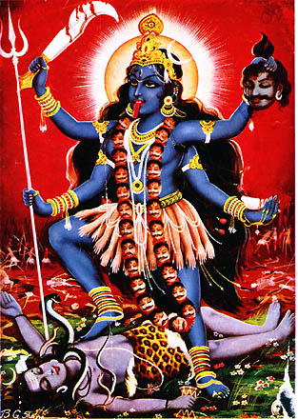
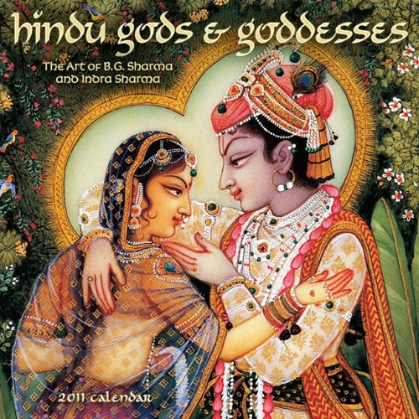
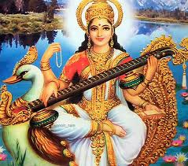
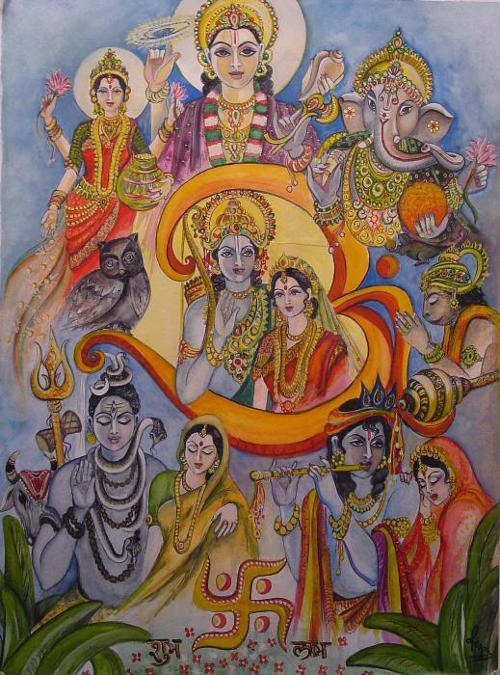
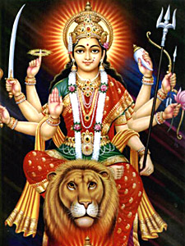
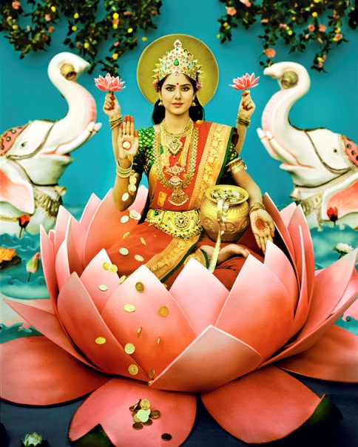
Each god has a wife or “consort” and these also come in many different forms

Slide 10
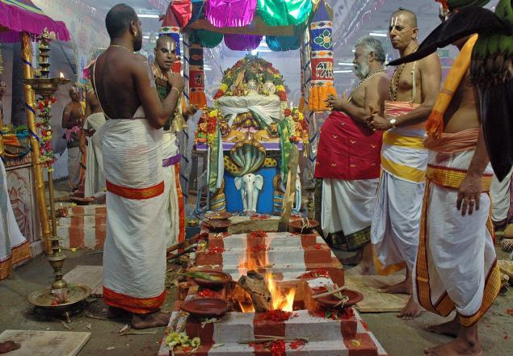
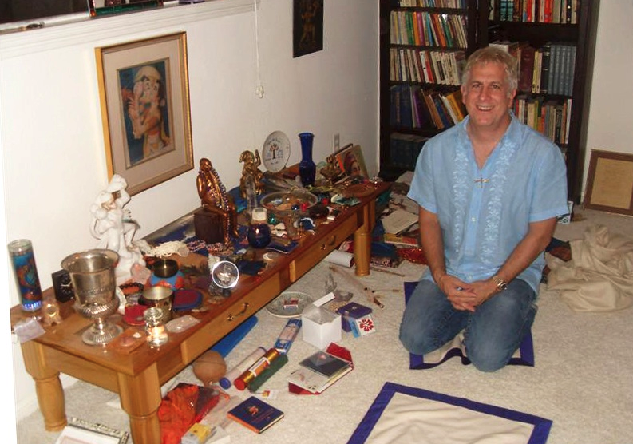
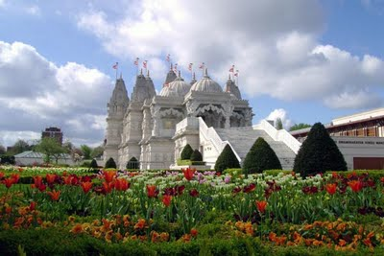
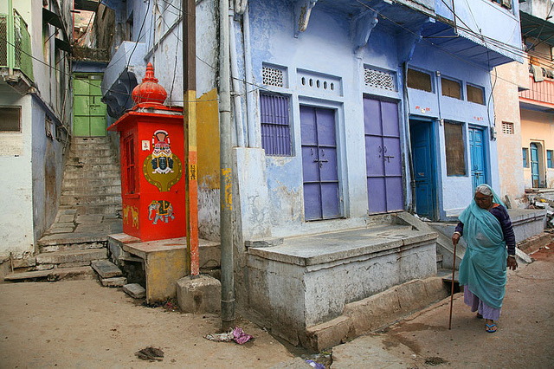
Puja – worship In the home, temple or…..anywhere because God is everywhere

Slide 11
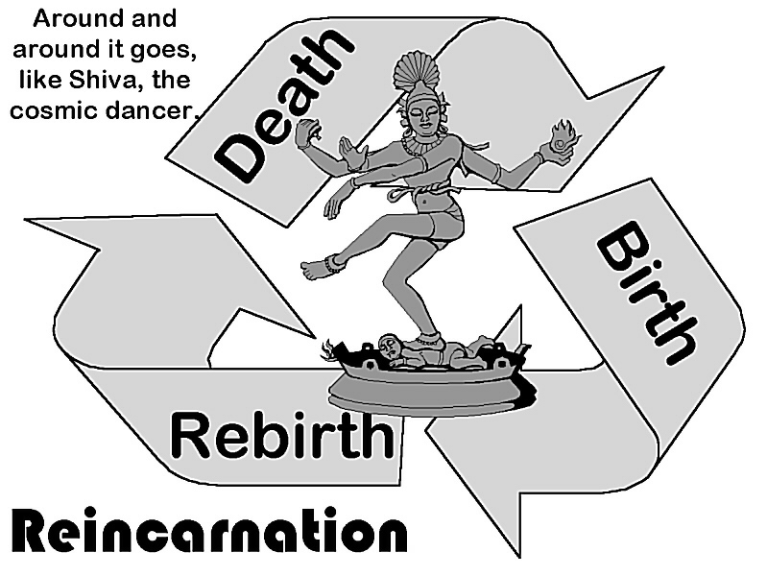
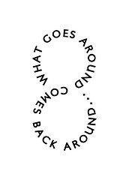
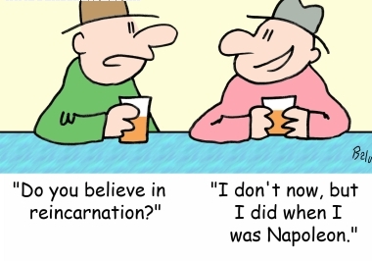
Karma = action
All actions have consequences
Good actions have good consequences
Bad actions have bad consequences
The consequences of your actions can be felt immediately, years later, or in the next life-time !

Slide 12
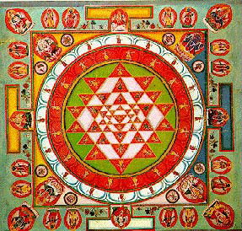
Yama – the 10 good principles of Hinduism
Good karma is…..
Remaining calm and patient
Respecting all living things
Being truthful
Controlling bad thoughts
Being compassionate
Purity in mind and body
Earning, not taking
Eating wholesome food
Being honest and honourable
Being determined to do the right thing

Slide 13
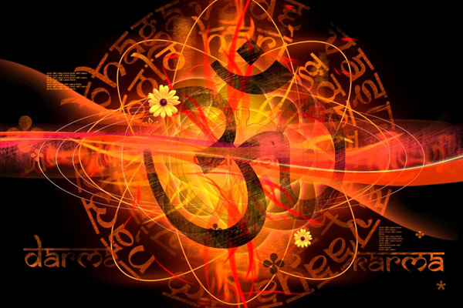
Moksha – being pure of spirit and re-united with Brahma (God)

Slide 14
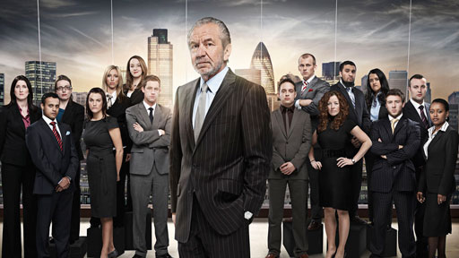
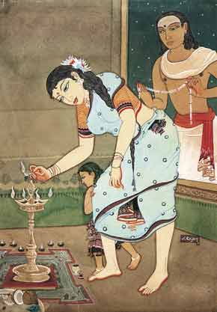
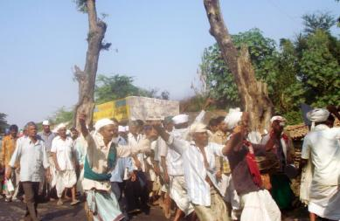
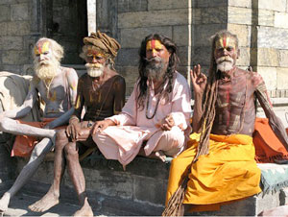

Slide 15
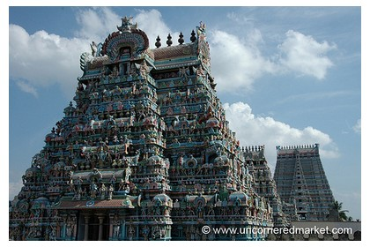
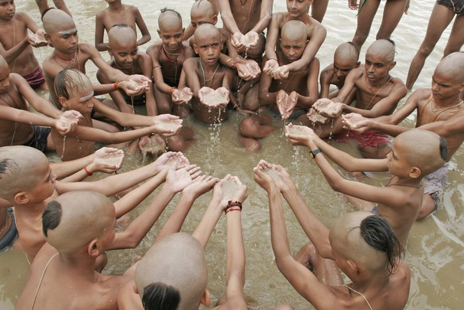
India is the birthplace and spiritual homeland for Hindus

Slide 16
The caste system – social structure, your karma determines which one you are born into?

Slide 17
The caste-system or a class system is the opposite of a “meritocracy”.
Meritocracy – you can reach your potential in life by merits – hard work and effort regardless of the family, neighbourhood, life that you were born into.

Slide 18
Acceptable or not?
There is an “under-class” or “outcaste” called the Dalit or untouchables.
Gandhi (father of India) despised the caste system and said that all humans deserve dignity and equality of opportunity.
This angered some Indians who didn’t want to change the system and it was a Hindu fanatic who shot him !!!!!

Slide 19
Re-thinking India – there are attempts to remove the caste system

Slide 20
Hindus in the world today

