Slide 1
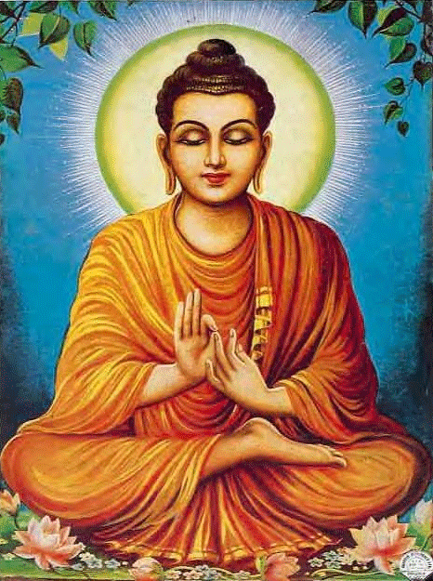
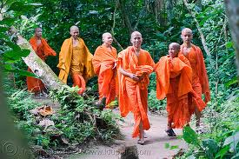
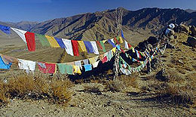
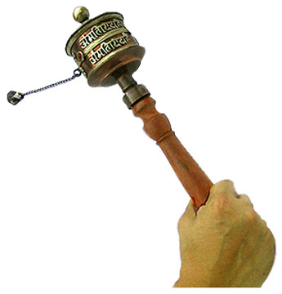
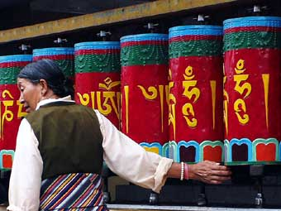
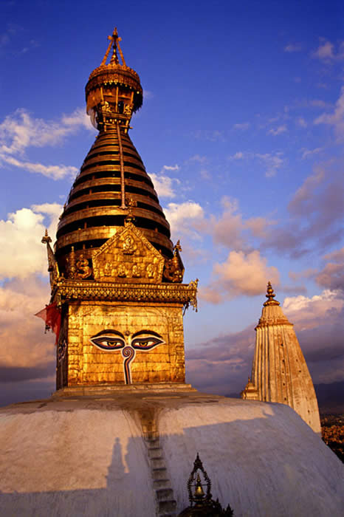
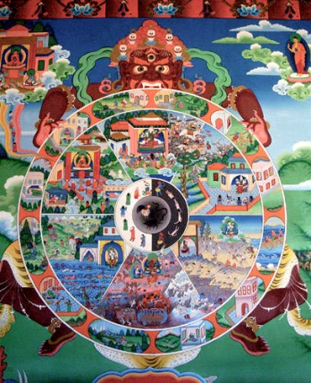
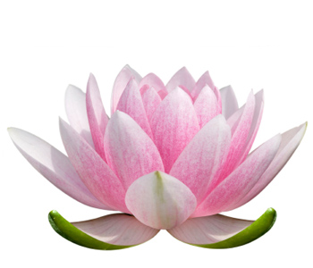
What is the religion?

Slide 2
Buddhism
Born Prince Gotama Siddartha in India
Saw four sights which changed his life – old age, sickness, death and a Holy man
Experimented with ways to find the truth (one was to starve his body of food)
Realised that the middle way is the way to live
Buddha means awakened or enlightened one.

Slide 3
Buddhists
A follower of the Buddha’s teachings is a Buddhist
If you want, you can follow the Buddha’s teachings and live your daily life but incorporate meditation in to it. (Lay Buddhist)
If you want, you can throw yourself totally in to the religion and become a monk or nun (you must shave your hair off, sever ties with your family and friends and wear orange clothes) – (ordained Buddhist)

Slide 4
The Dharma
After his enlightenment, the Buddha recommended 8 ways to live your life –called the Eightfold Path.
The Buddha’s teaching is called Dharma.
His teachings are written down in the “Dhammapada” or path of wisdom.
The Buddha only advised that if you wanted to be free of suffering then you could follow his teachings, if not, so be it!

Slide 5
Samsara and Nirvana
The Buddha said life is like a wheel, we go round and round and round and round……
He said that this continual state of existence (samsara) was really suffering and quite unsatisfactory.
He said that we can escape constant birth, death and re-birth by working towards enlightenment (Nirvana)

Slide 6
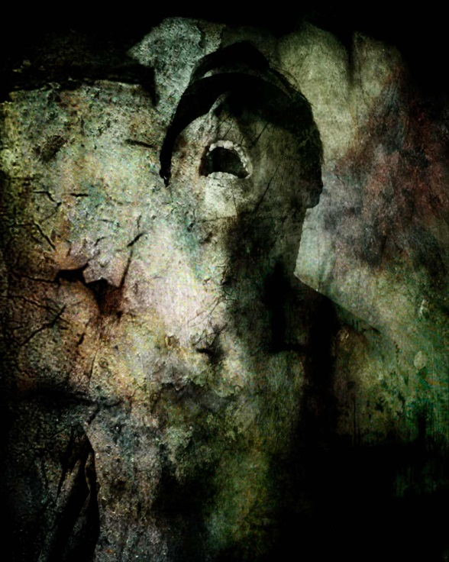
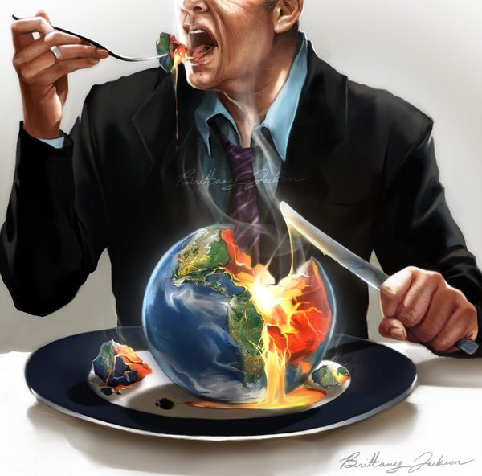
The Three Poisons - Greed – Hatred – Ignorance – the cause of all suffering.

Slide 7
Buddhahood or Wisdom
The Buddha said that all beings experience pain and suffering.
The trick is to learn from the pain and suffering.
He said that even a beautiful Lotus flower can grow in a muddy pond.
We can learn, grow, develop, realise in all situations.

Slide 8
Aids to prayer and meditation
If you go to a Buddhist country you may see prayer wheels and prayer flags.
These contain the teachings of the Buddha on them.
Wheels are spun around and the flags blow in the wind so that the Buddha’s words can reach everybody.

Slide 9
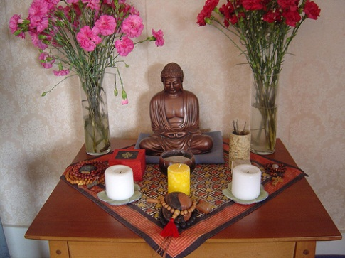
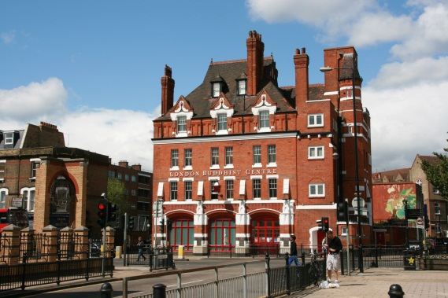
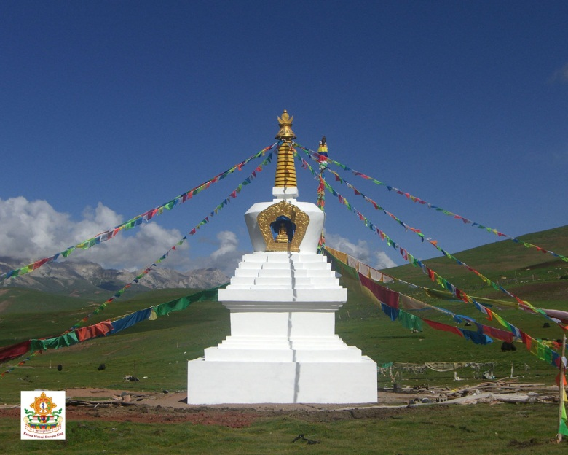
Places to meditate
In a Buddhist country, there will be stupas as a focus for worship and a reminder of the Buddhist teachings.
In London, there is an old fire station that is now a Buddhist centre.
A shrine can be set up at home to meditate at.

Slide 10
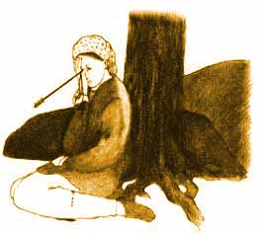
God????
The Buddha said that there is no time to discuss whether or not there is a God.
He said, if you had an arrow in your eye, would you want to discuss how it got there before it was removed?
When you are suffering the best thing is to get on with overcoming it – the Buddha said, follow the eightfold path.

Slide 11
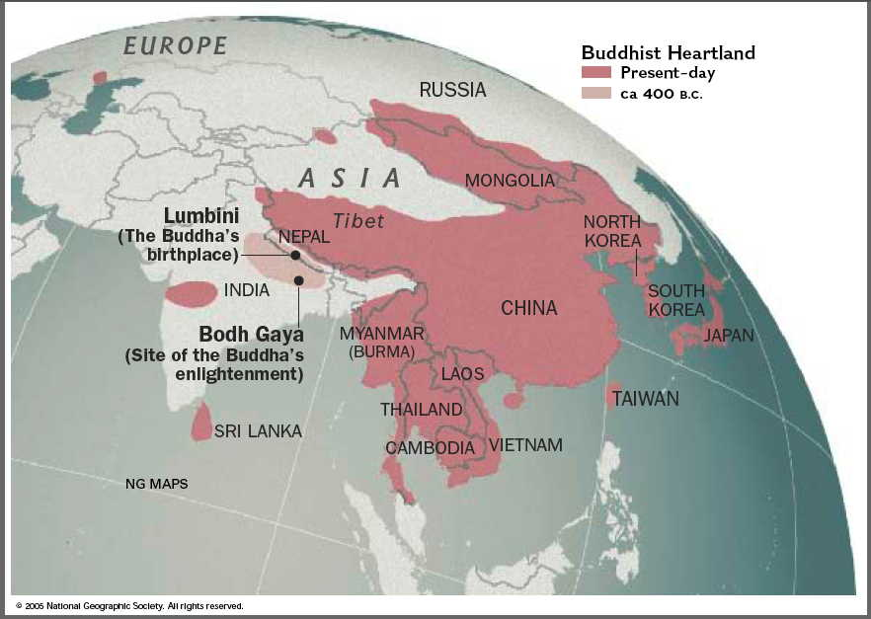
Buddhism in the world

